Slide 1
Hardwood Management in the Coast Region
Implementation: A guide to where, when and how.
Neil Hughes RPF
Spring 2012

Slide 2
A Practical Approach
Silviculture
  Why and where to manage for hardwoods
  Site identification and getting it right
  What makes a good hardwood tree and stand
  Decision making based on good information
2. Strategic issues – by Management Unit

Slide 3
Silviculture
1. Why do we manage for hardwoods
Hardwood Timber production and long term forest resilience
To minimize the regeneration period and costs on sites traditionally recognized as difficult to regenerate to conifer
Notes:
We have already covered the objectives behind the new hardwood strategy, the principle being that it is one of diversification of the timber supply which also fits extremely well with the concept of increasing the resilience of our forest. We have also touched on the fact this is going to be a fairly small program on a Regional scale, with eventual targets of 1200ha per year to yield 300,000m3.
Choosing the right site to grow them on is therefore critical, to maximize the return from these small areas.

Slide 4
Silviculture
1. Where do we manage for hardwoods
Alder plantations on the site series where conifer are difficult to establish and alder will grow extremely well
Alder plantations on those sites where we know it will regenerate very heavily and grow to its potential
Mixed wood blocks on the same sites which regenerate heavily.
Notes:
There are 3 basic possibilities which are going to cover the majority of hardwood management scenarios.
Firstly, the alder plantation on the heavy brush site, the 05/07 complex or the pure 07, the flood plain sites if you are still able to operate on them. The classic toe slopes and lower slope receiving sites where salmonberry, thimbleberry and elderberry are solid and natural regeneration of most tree species is hampered. With effective site prep red alder can get established and to free growing much quicker than conifer and these rich sites will yield harvestable stands in 20-30 years.
Secondly, there are the fresh 05 sites where there is somewhat less brush cover and with even a bit of disturbance during harvesting very dense red alder regeneration can occur. These sites can be the most productive for alder (in terms of volumes / hectare if not individual tree size) and are usually very easy to regenerate because they can infill with naturals to fill blanks, unlike the 07 sites which often do not.
The third scenario, and the one we are going to spend most time considering, is the mixed wood approach on the sites just described. The big problem with natural regeneration of alder is its unpredictability. Leaving sites to regenerate is generally risky without well distributed site disturbance, and so is not a recommended practice. Planting to conifer and then managing alder natural regeneration as and when it appears is generally a better approach when we can practice adaptive management and consider “mixed wood” management.

Slide 5
2. Site Identification and Getting it Right
2.1 Alder Planting
Moisture and Nutrients, but in the right quantities:
Soil texture very important – fine textures which help to retain moisture. Alluvial silts and fine sands are the best, coarser sands even on floodplains can be impossible to establish trees on.
Notes:
Zonal sites can be moderately productive, but avoid Droughty mid summer sites – must get adequate moisture through August when height growth surges.
Flood plain sites need to be considered carefully – look for those coarse gravelly deposits that are frequently found on low and mid bench sites and which may at first site appear to be great alder sites. Cottonwood is frequently a better choice if it can get established.

Slide 6
Slope position is very important with the lower and toe slopes providing the best sites except in some of the richer and wider valleys where some flatter sites are extremely good.
Fluctuating water tables, seen as site series 13,14,
can be extremely productive, such as over marine silts/clays,
or dreadful, as found in places on eastern Vancouver Island.
Notes:
The best alder to date is growing on high benches of the wider river valleys and on toe slopes – section 2 on Management Units will outline some of the more productive areas identified so far.
There is a lot of alder that has regenerated heavily on seasonal water tables on the east coast of the island but they do not develop into really productive stands – usually high stocking density but small individual tree size often of lower quality.

Slide 7
Alder Plantation Establishment
High quality bareroot or plugs – 310 ½+½ or 512 / 515
Improved seed may become available as seed orchards are established
Site prep treatment with either herbicide or mechanical screefing is extremely important to get quick establishment and take advantage of alder’s rapid early growth.
Aim for canopy closure by year 4.
Notes:
There have been many presentations on this topic over the last ten years, so this is just a brief outline of the vital concepts.
The availability of improved seed could be very valuable; the Weyerhaeuser program in the US has already extracted similar growth advantages from it’s alder breeding program to that achieved with Douglas fir.

Slide 8
Other factors vital to consider:
Humus layer depths
Aspect
Frost
Elk and deer – damage OR cost reduction
Bark Beetles
Notes:
Although alder can be very productive on sites with thicker humus layers, re-establishing it by planting is difficult and establishment can be quite slow. Roots need to get into mineral or black and rich organics at the very least. Site disturbance to mix humus with upper mineral layers is extremely effective.
Hot south facing slopes are also very difficult to establish, even if you have just harvested good alder from them. Sun scald and drought are a real problem until canopy closure provides shading to the stems and soil.
Frost is probably the number one consideration with planting location selection . Avoid frost hollows and areas where cold air ponds. The flats of valley bottoms especially up against standing riparian timber can be sensitive. It is generally late spring frost from mid April till early May that kills seedlings by killing cambium on the lower stem girdling the tree. Trees are usually able to withstand these events by the third growing season but exceptional frost can damage older trees.
Elk are becoming a serious concern, the MoE program of introducing elk throughout the Sunshine Coast and now in the Fraser valley is causing more and more trouble. They generally do not browse so unlike conifer, alder establish quickly but they begin to rub as soon as the trees are 3-4m tall. Plantations are beginning to suffer and the long term effects are unknown. High stocking from natural regeneration is a good solution. Deer browse has mostly been negligible and has saved money in some situations like Nelson Island.
The alder Bark beetle is a necessary consideration with plantations. Serious stem damage and growth impacts can be caused by the beetle and the best solution is to allow sites to fallow for a year before re-planting. Effective slash reduction by burning also works but is becoming increasingly difficult to carry out.

Slide 9
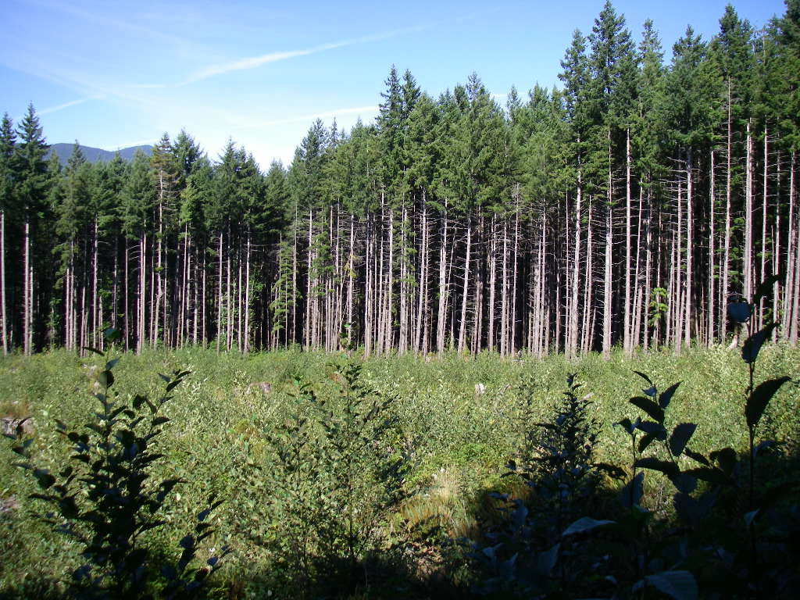
2.2 Mixed Wood Management
Focus of Mixed-wood management for now will be Red Alder
Lack of experience with other species to date.
Birch and Maple should be considered for trial purposes as appropriate.

Slide 10
Different types of Mixed Wood Management
Stratified mixtures (deciduous overstory with conifer understory)
Intimate mixtures (both components show dominance on site)
Mosaic mixtures (distinct patches) – stratified in distinct hardwood and distinct conifer patches
Coast strategy will initially focus on Mosaic mixtures in small to medium size patches
Notes:
We will discuss the concept of the various classes of mixed wood labels later in the presentation, for now we just want to focus on the different silviculture options and interpretations of mixed wood.
Stratified mixtures is often the concept most foresters will have for a mixed wood approach and is typical in the boreal forest or central interior where an overstory of aspen or birch has an understory of spruce developing. The overstory deciduous can and often is harvested first and the conifer left to develop further. We do see these stratified mixes on the coast also, where often a full canopy of alder has a patchy distribution of hemlock / Cw / Ss understory of variable heights. However, there is rarely enough uniformity in stocking to manage this conifer for a follow on crop. Girdling to kill the alder overstory has been a common practice, especially in riparian areas, followed by fill planting as necessary. This however completely wastes the value in the alder overstory.
Intimate mixtures – A common scenario, where there is a deciduous component scattered through a conifer plantation often quite well distributed and with some small clumps heavy to alder. Conifer and alder will be of similar size and vigour for a certain period and management intervention by spacing/brushing can result in a truly mixed forest where conifers and alder would grow adjacent either as individuals or small clumps through to maturity. Many of the stands harvested under the NWH licence fit this description although they of course had no management intervention. Due to our current lack of experience with this and the need to intervene with possibly more than one spacing to maximize value at rotation end this hardwood policy suggests we only consider this on a trial basis.
Mosaic Mixtures or Patch mixtures will be the strategy of choice for this policy. In essence the patch approach is based on managing mini alder plantations within a stand originally planted to conifer. What was initially a 20ha block planted to conifer may have very dense alder regeneration in distinct areas such that by FG it may be, through a well documented process, only 13ha of conifer with two distinct alder patches totaling 7ha.

Slide 11
2.2 Mixed Wood Management
Site Characteristics
To consider a site for mixed wood management, it must still be one suitable for long term alder vigour
Avoid sites where alder can establish rapidly and quickly takes over but it will not be sustained – many zonal and slightly drier sites.
VI East Coast sites can fit this category.
Notes:
So, typical 05 and 07 sites still favoured.
The Hardwood Silviculture Coop has shown that unlike most conifer species, early growth of Alder is generally independent of site quality. Meaning that over the first 10 years at least, alder stands can show little indication that the long term productivity is unlikely to sustain them.

Slide 12
Jump Start for Alder
Mixedwood allows you to avoid the regeneration risks of planting alder; focus on healthy, vigorous alder that is beyond the frost or vole damage phase.
Notes:
Especially at this point, there is the chance to add to the alder growing stock by targeting conifer sites just coming up for brushing treatments – this is the best opportunity to increase the amount of alder in the short term.
By using natural regeneration that is well advanced you are able to pick out real good quality stands that is beyond the regeneration stage where most risk to alder seedlings occurs.

Slide 13
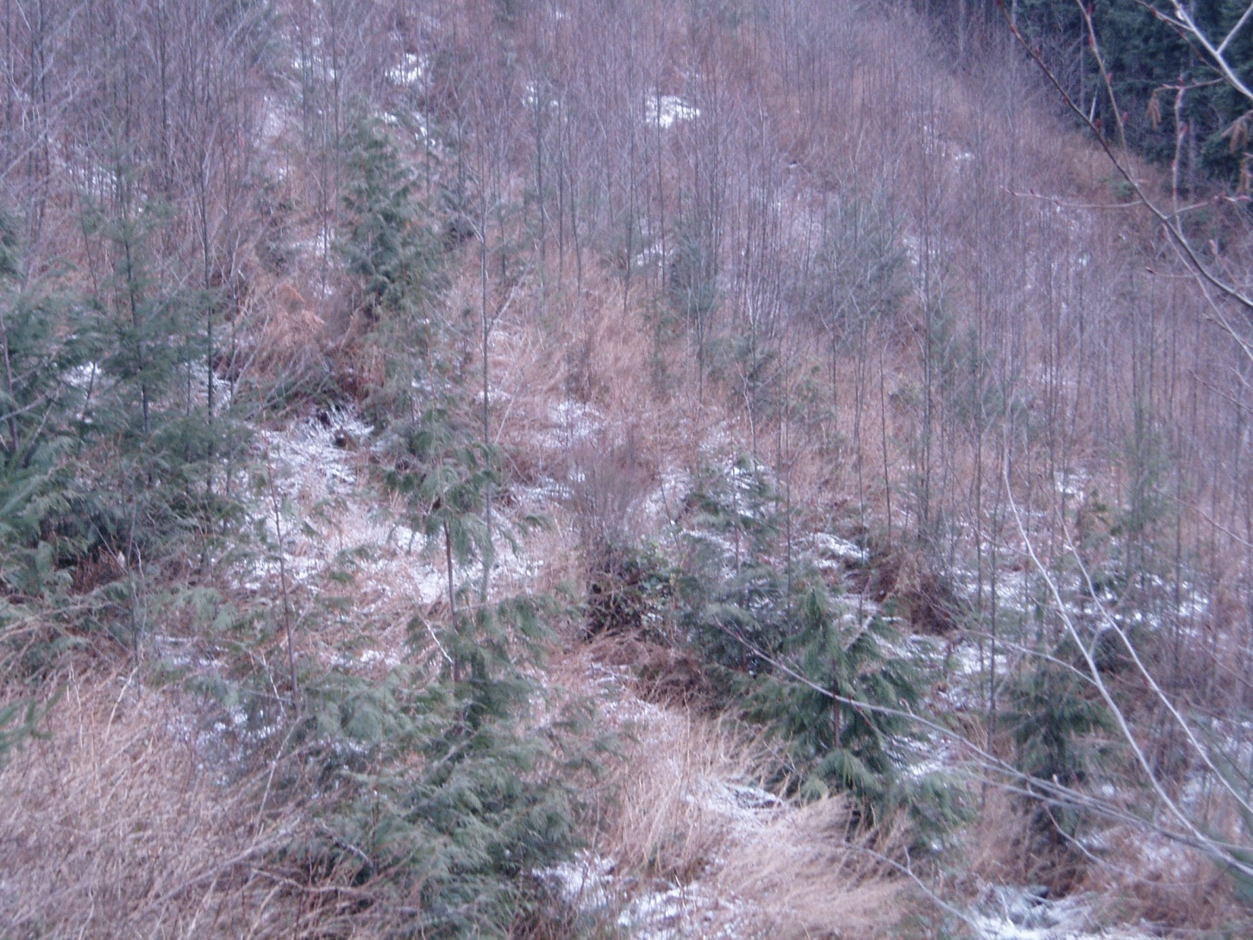
8 year Fd on 05//07 site with heavy Dr regen

Slide 14
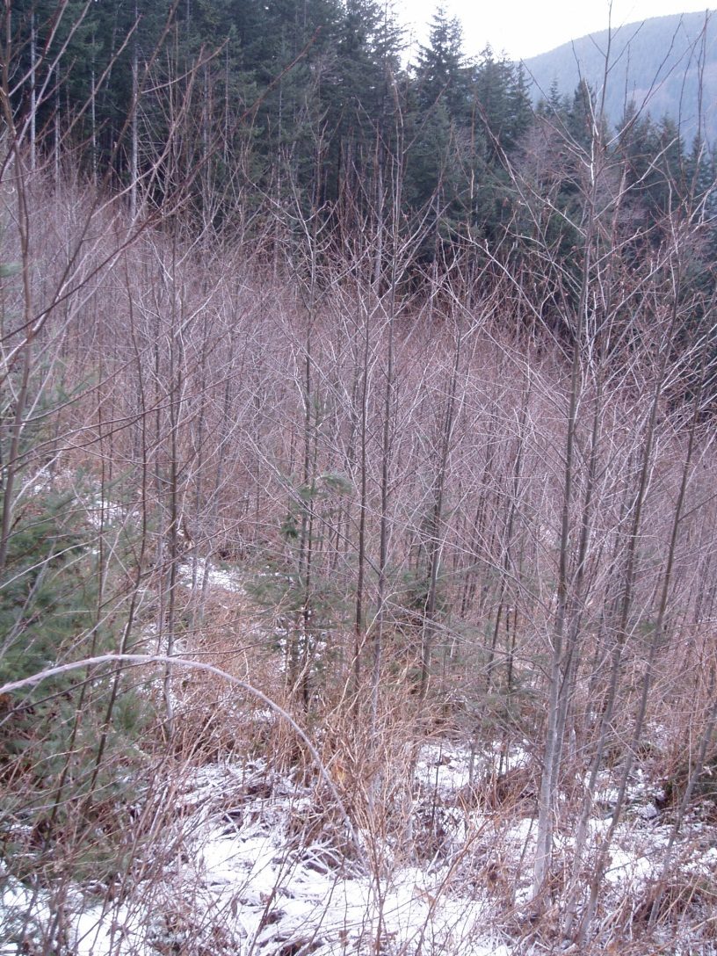
This block has some of the best alder seen to date for form and vigour and was spaced in January 2012.

Slide 15
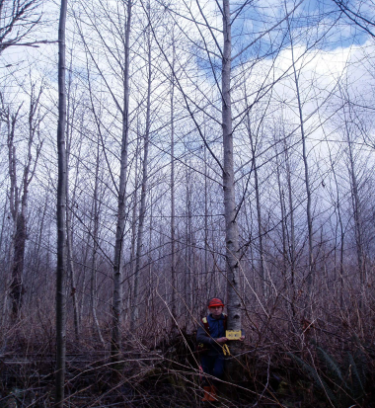
What makes a good alder tree
Vigorous height growth
Stem Form – free of crooks and fork
Branch size and number
Amount of live crown
Notes:
Growing alder is all about rapid early height growth. Probably even more so that Fd, alder needs a low competition level with shrubs and grasses, but really benefits from intra-tree competition ie isolated and sparse alder are generally not great crop trees.

Slide 16
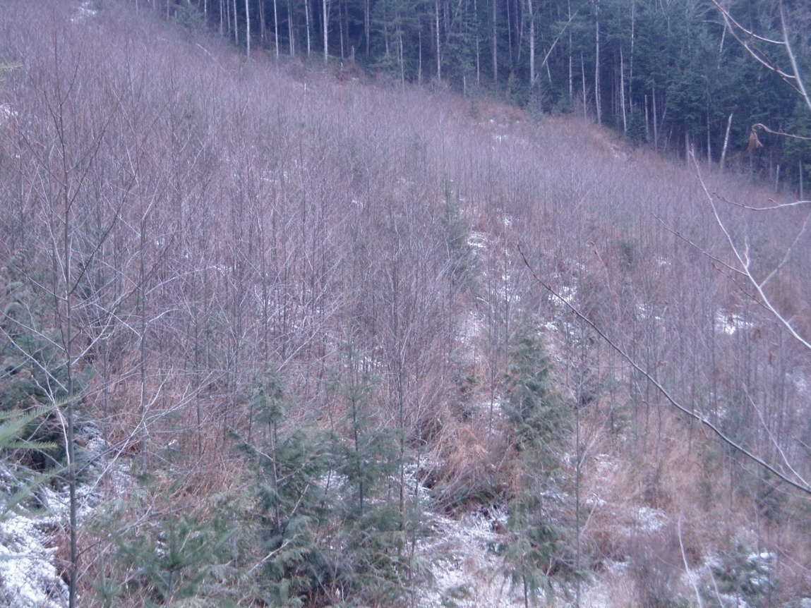
What makes a good alder stand?
Stocking Density
1000- 1,500 sph at establishment.
600 – 1000 sph by the early Free Grow stage

Slide 17

A good Alder Stand
Uniform Distribution of
Stems within the stand:
Keeps branch size under control
Keeps live crown depth under control
Maintains good height growth and stem form.

Slide 18
Base Decisions on Good Information
For Plantations – careful ecological classification at the SP stage and post harvest confirmation that the site is suitable
For Mixed Wood – maintain an inventory of sites that are potentially going to have heavy alder regeneration.
Plan to survey these sites on a schedule that fits in with identifying the regeneration patterns of alder.

Slide 19
Mixedwood stand identification
First wave of alder regeneration usually apparent by about the 3rd growing season after harvest, make sure surveys around this time document seedling regeneration carefully.
Critical survey time is 5-7 years after planting -alder now well expressed and will either need brushed to ensure FG of conifer or the decision taken to move to mixedwood mgt.
Notes:
Initial surveys for regen delay may not adequately identify the extent of alder regen – one or two seasons after planting may not be enough time to give the first wave of alder time to express itself. Plan to survey around the end of the 3rd growing season, even if it is just a just a walk through with a limited amount of plots to get some baseline data. What this will do is enable you to move the block from the potential list onto the possible or probable list. You can also make your first tentative plans as to possible brushing requirements in relation to deciduous.
Vigorous conifer will just be starting to respond to alder competition by about year 5 or 6 and this is when management decisions need to be made – confirming that mixedwood management is not simply a case of management by default but a well thought strategy to deal with complex ecological conditions and a process to optimize silviculture expenditure.

Slide 20
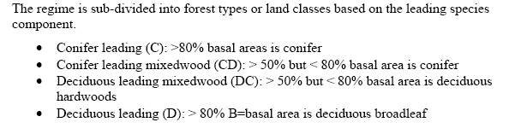
Stratum Definitions

Slide 21
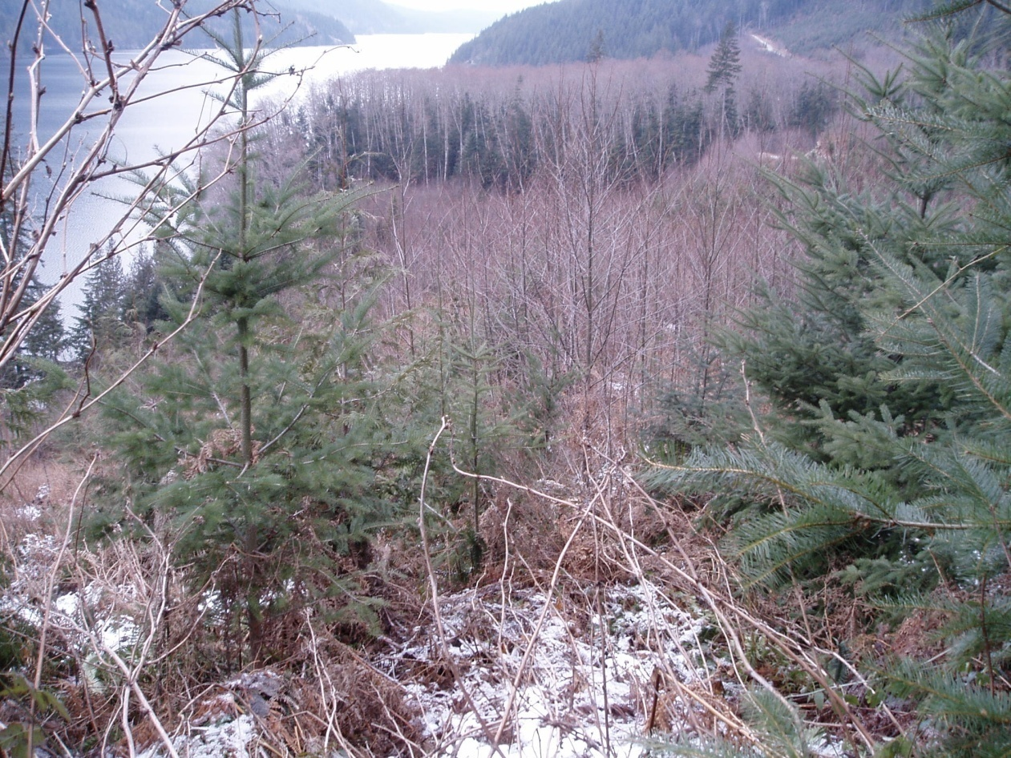
Survey Strategy
Pre-Stratify into
C, CD/DC or D
Aerial survey best
Otherwise previous
Survey and/or view
From high ground.
Notes:
Before starting to survey it is best to try to pre-stratify into the dominant forest cover. In some respects this is easier in winter with no leaves since it actually gives a better impression of stocking density for the alder. Beware non alder deciduous ie cherry, willow and on the mainland the common species, birch.
This will enable you to think ahead to which species you think should be dominant and make decisions about brushing or the consequences of leaving conifer as “ghost trees”. Assuming you are in a DC / D you would be going into it planning on looking for 3 to 6 alder per plot and thinking about stem distribution, stem quality and most importantly thinking about the stratum size for future development. We have currently suggested a half hectare rule of thumb for D, I would suggest that could become smaller as we get more comfortable with the concept.

Slide 22
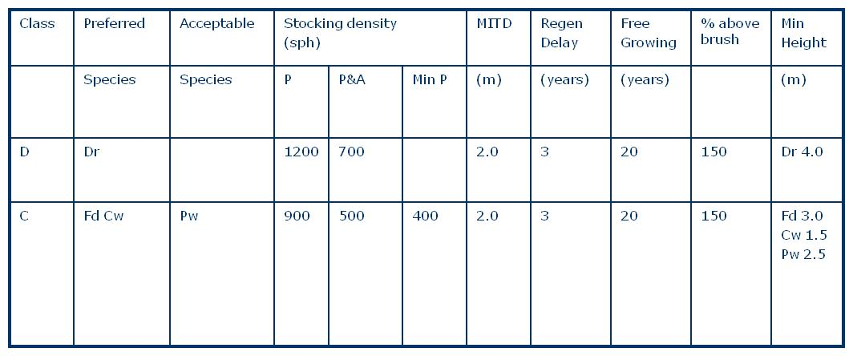
Mixedwood stocking standards
Notes:
The alder stocking standards are somewhat lower than those typically used for intensive establishment of plantations, but by the time these surveys are being carried out the alder is already past the early establishment stage and you will be able to judge for yourself the quality of the trees. Ideally if stem form and branch size are good, and height growth indicates high vigour then 600 – 800 sph is potentially an adequate number to produce an exceptional crop of sawlog trees. Not surprisingly, these are the numbers suggested for most post spacing prescriptions.
Conifer standards are typical for whichever rich site series you are on ( here an 05) – what you are looking for are vigourous and healthy trees that can withstand competition from the adjacent alder.

Slide 23
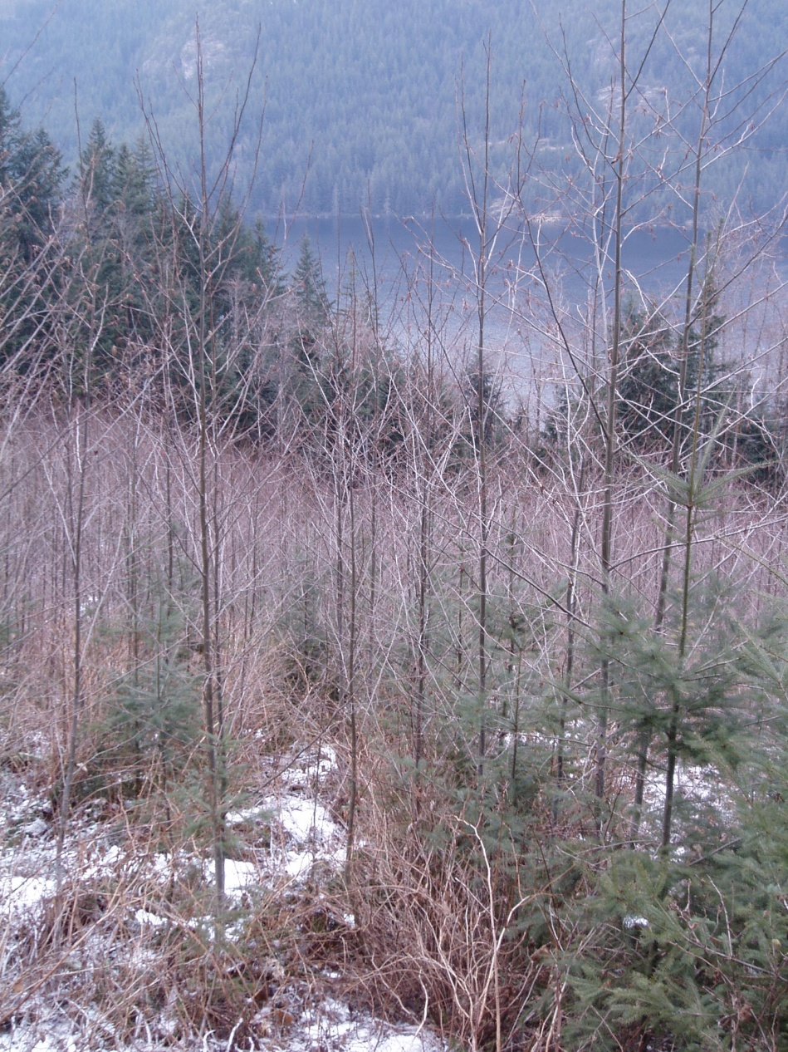
Survey Strategy
For initial C or D stratums think of the other species as:
ghost trees – conifer
To be brushed - deciduous
Notes:
When in areas clearly identified as conifer, surveyors should be thinking about brushing treatments and FG requirements of the conifers.
When in the areas clearly identified as alder leading, consider if spacing treatments might be appropriate – has dominance expressed, will spacing be needed to focus growth on fewer stems.
Rule of thumb – stands with more than ~2500-3000 should be spaced to no less than 1000 sph to avoid crop damage from snow press and wind damage. Stands with less than ~2500 and with moderate dominance expressed can be spaced to 600-800 sph. Any alder patches where dominance is clearly shown by a well distributed portion of the trees need not be spaced. There is some good data emerging that the best 250 sph in alder plantations are independent of stocking density.

Slide 24

Survey Strategy
For C/D or D/C survey with two stocking standards
Allocate according to how each plot falls ie either C or D
Summarize stratum by the % of each type
7 plots C and 3 plots D
Notes:
As discussed, alder natural regeneration is very rarely uniform and the chances of finding hectares of well distributed alder over conifer is remote. More likely 60-70% of a stratum will be well stocked but some smaller percentage will have much poorer stocking and likely the conifer are doing well. This is going to be where the second stocking standard, for the conifer, comes in as at each plot you will need to identify the leading designation and then utilize the applicable broadleaf or conifer stocking standard for that unit.
The surveyor will also need to make decisions on whether the conifer will remain FG or might need some brushing.

Slide 25
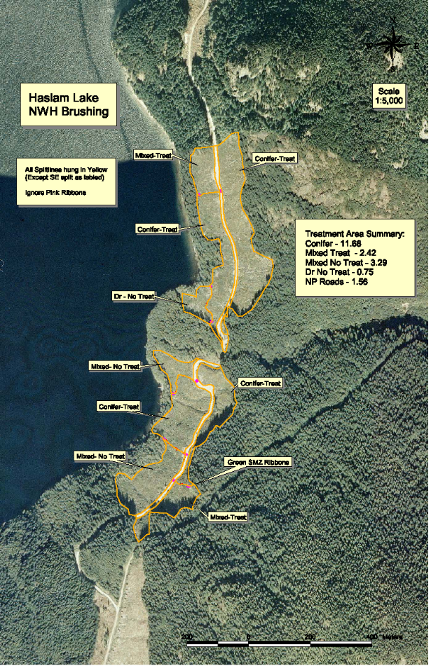
Survey Strategy
Re-stratify the block as necessary following summary of survey
Prioritize brushing treatments to achieve conifer FG
Schedule spacing of alder if stocking suggests necessary.

Slide 26
Reporting Requirements
Correctly recording inventory and Silviculture layers for forest cover labels
Tracking of how much individual licensees are establishing or converting
Tracking of how much is collectively being done in each District.
Beginning to consider implications on timber supply
Notes:
What should the silviculture label look like ? Should it just include mixed species or do we separate the stratums and record individually? Ie 10 ha of Dr7 Fd2Cw1 or 7ha of Dr10 and 3ha of Fd7Cw3 ?

Slide 27
Juvenile Spacing
Objective to lower stocking density into the desired range 600-1200sph depending on initial stocking
Ensure rotation age reduced into 20-30yr range
Focus growth on the best quality stems – critical not to lose volume in the process
ie do not sacrifice inter tree spacing for volume

Slide 28
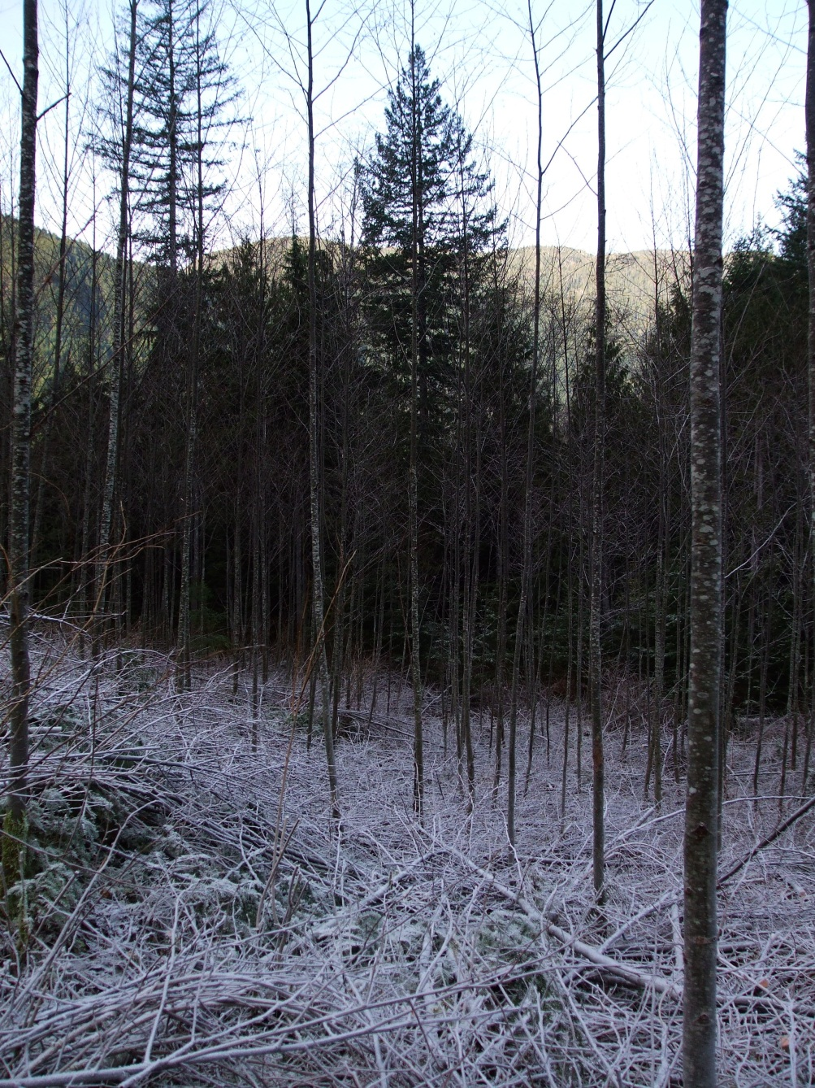
Juvenile Spacing
Best Investment?
High density stands 3000sph or more?
Lower density stands 1500-2000 sph ?

Slide 29
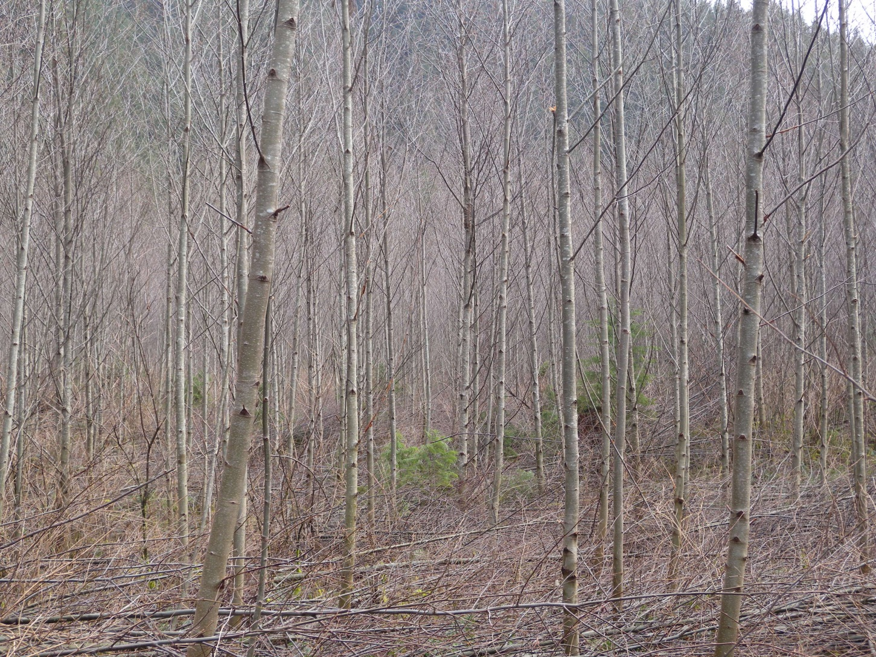
Cutter Cove, 10yrs, spaced March 2012
Pre stand treatment density 3000sph
Post spacing density 700sph

Slide 30
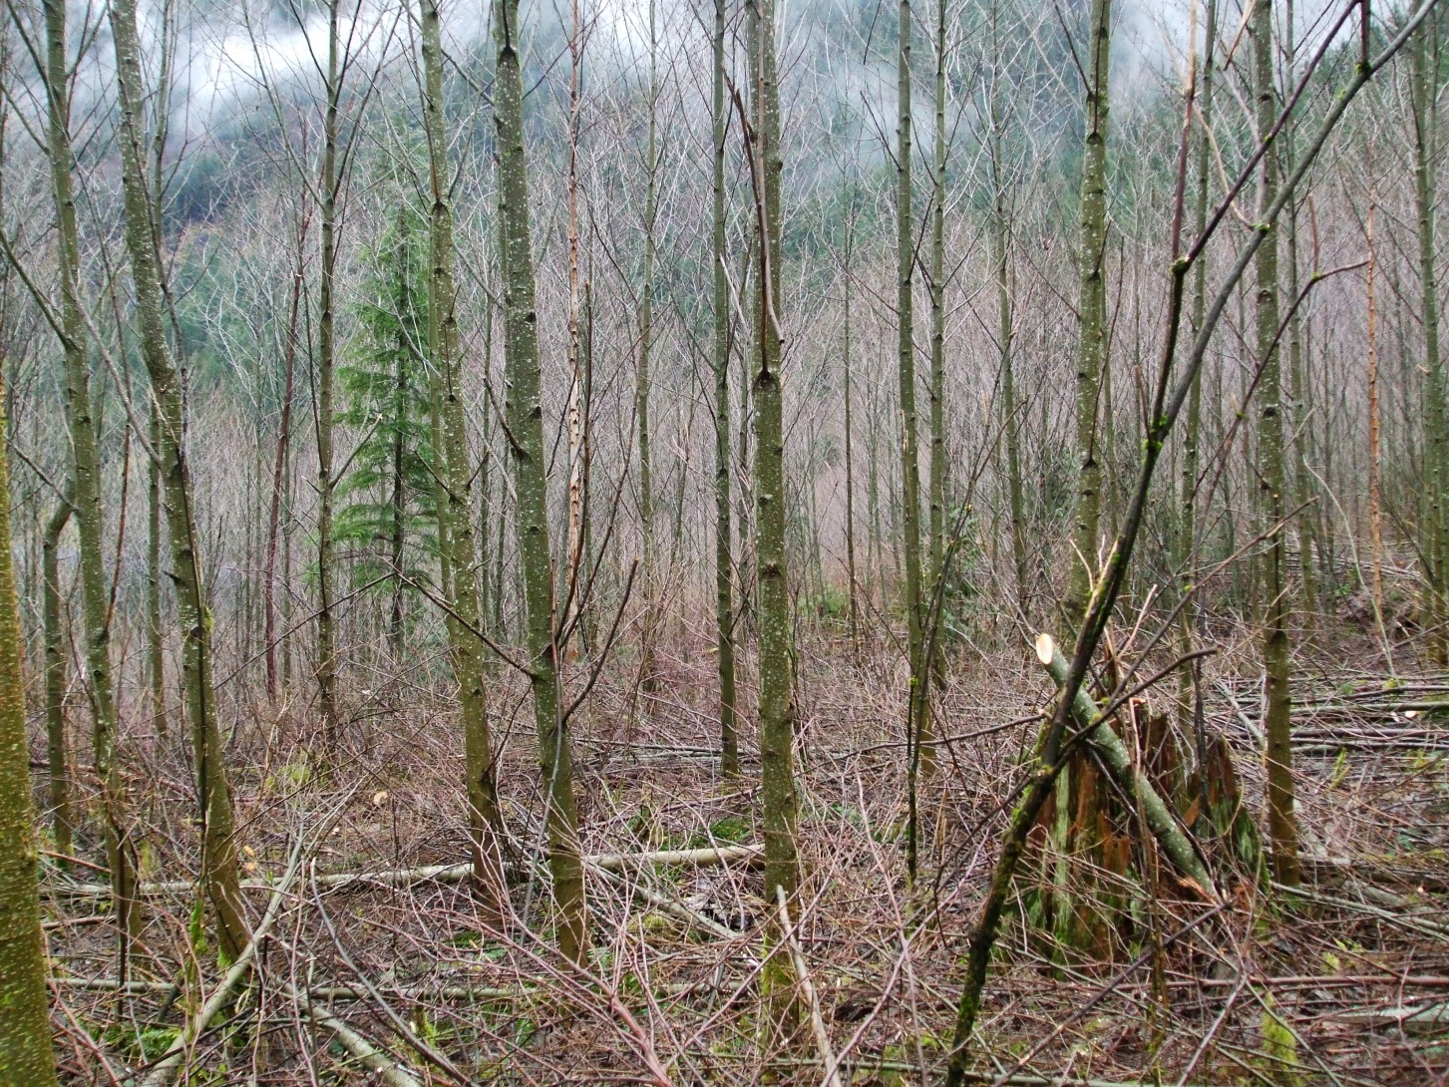
Bute Inlet Spaced January 2012
Pre Stand Tending 1700sph - Post 700sph

Slide 31
District Allocations
Based on initial concept of providing the timber supply for a viable hardwood business.
Rough split based on ability of Districts to provide suitable sites for deciduous management
Notes:
As previously mentioned, the initial target was to provide enough supply for a viable manufacturing industry to be maintained, somewhere in the region of 300,000m3 annually which equates to 300m3/ha from 1000ha.

Slide 32
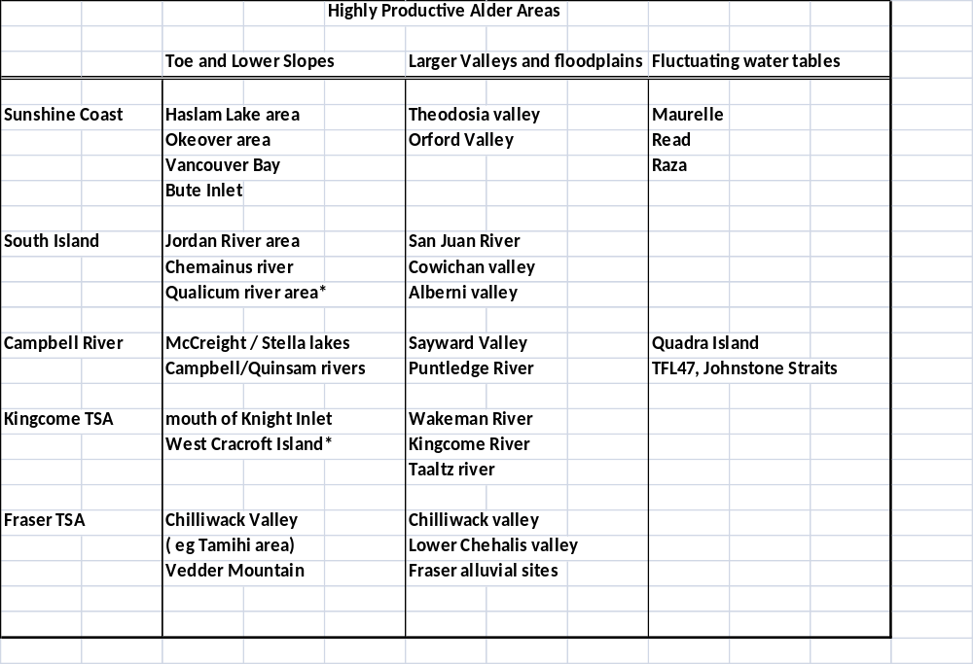
Good Growing Sites – building forest cover
Notes:
This is just based on historic stands of very good alder harvested over the last 15 years and observation of the newly developing plantations.
When considering the strategy for building up a new supply of alder, it may make real sense to create core areas where there is a large amount to base operations upon – whether it is spacing programs or future harvesting. There are already some good areas developing around Powell River, in the Theodosia valley and around Campbell River. The lower Chilliwack valley would be an extremely productive area – some of the best alder sites encountered were around the Tamihi valley where a real opportunity has been lost.

Slide 33
Licensee Allocation
Develop a District cooperative plan to allocate area amongst the various Licensees in the District.
This should not be hard wired – harvest programs may mean some will have no suitable sites some years while others have far more than allocated.
Excellent option for woodlots and community forests where there is a high level of interest in hands on management.
Notes:
In the Campbell River District with Interfor, Timberwest, WFP, BCTS this could be < 50 ha per year.
Similarly in the Sunshine Coast with WFP, Interfor, Terminal, BCTS and Community Forests <50 ha each per year
This might mean only two or three blocks per year, but more likely more smaller areas.

Slide 34
Timber Supply Issues
Negligible impact on conifer supply, big boost to industry with high value product potential and well developed market demand for it.
Potential to address mid term supply issues with 25-30 year rotation plantations
Mixedwood stands will provide diversified products which is proving to be a valuable strategy to combat cyclical commodity markets.
Notes:
Another issue that has been considered is the place red alder may have as a “filler” in a climate change strategy. A 25-30 year rotation can be used to but time while we develop new silviculture strategies based on adapted species and provenances as the full impact of climate change develops.

